Slide 1
Hello!
Myself
Aman Maurya
I am presenting today the topic :
Mathematical calculations using cell reference

Slide 2
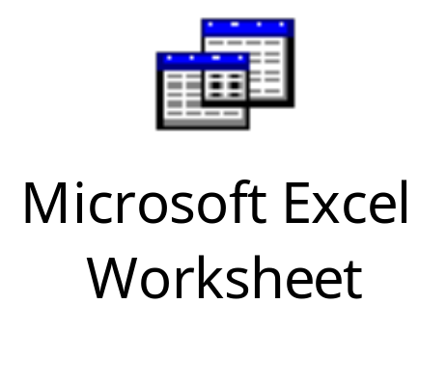
Cell reference types and examples
A cell reference in Excel identifies the location of a specific cell using its column letter and row number. It’s crucial for creating formulas.
There are three types of cell references:
Absolute ($) references: These stay fixed when copied.
Relative references: They adjust based on the new location.
Mixed references: These combine absolute and relative components.

